Slide 1

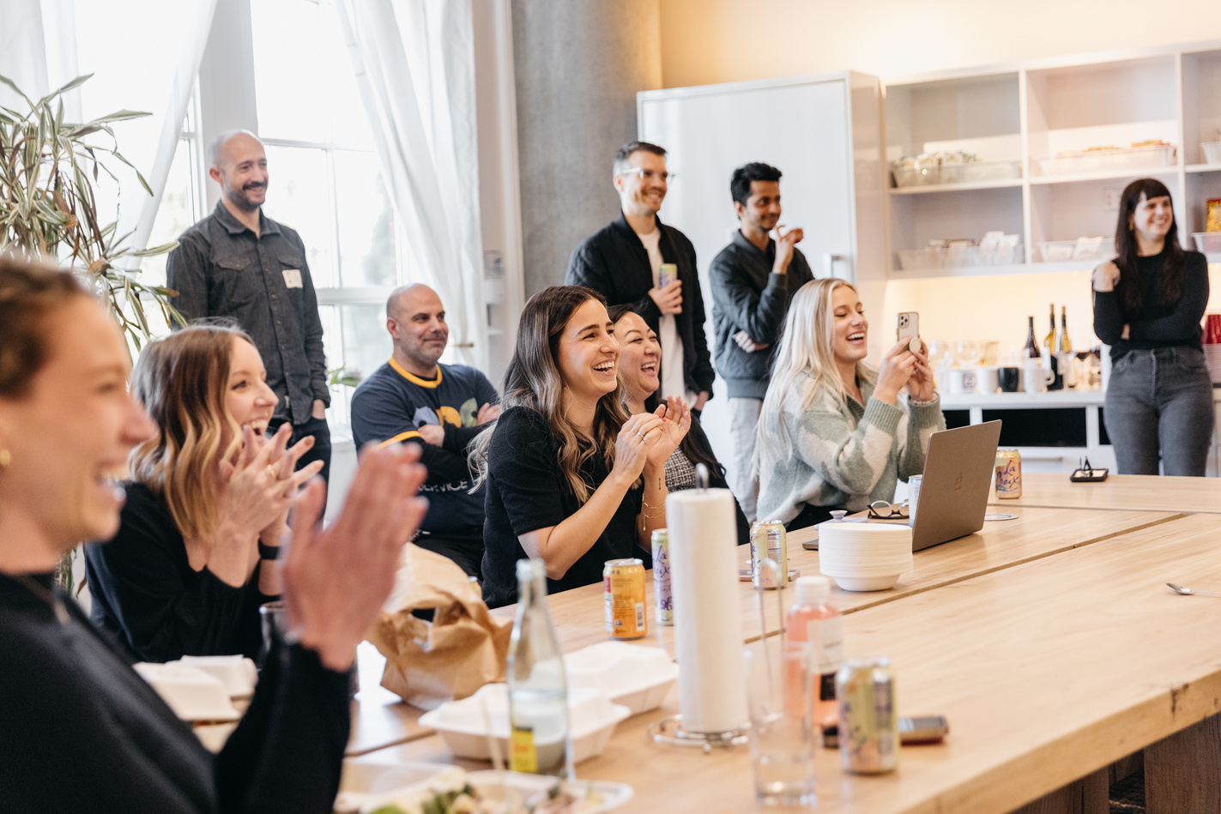


June Offsite
Welcome Packet

Slide 2





Hi team!
Welcome to San Francisco. This is going to be a week full of fun and excitement that will help us build stronger connections with one another.
Explore this packet to find all the info you'll need to get the most out of this offsite.

Slide 3


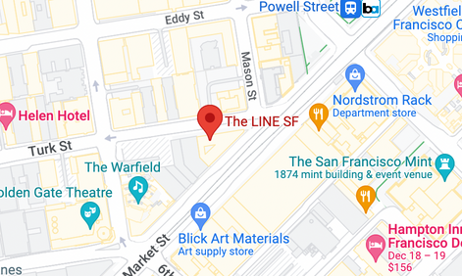


Important details
The LINE SF
33 Turk St, San Francisco, CA 94102
Main contact
Amanda S.
(XXX) - XXX-XXXX
amanda@company.com

Slide 4


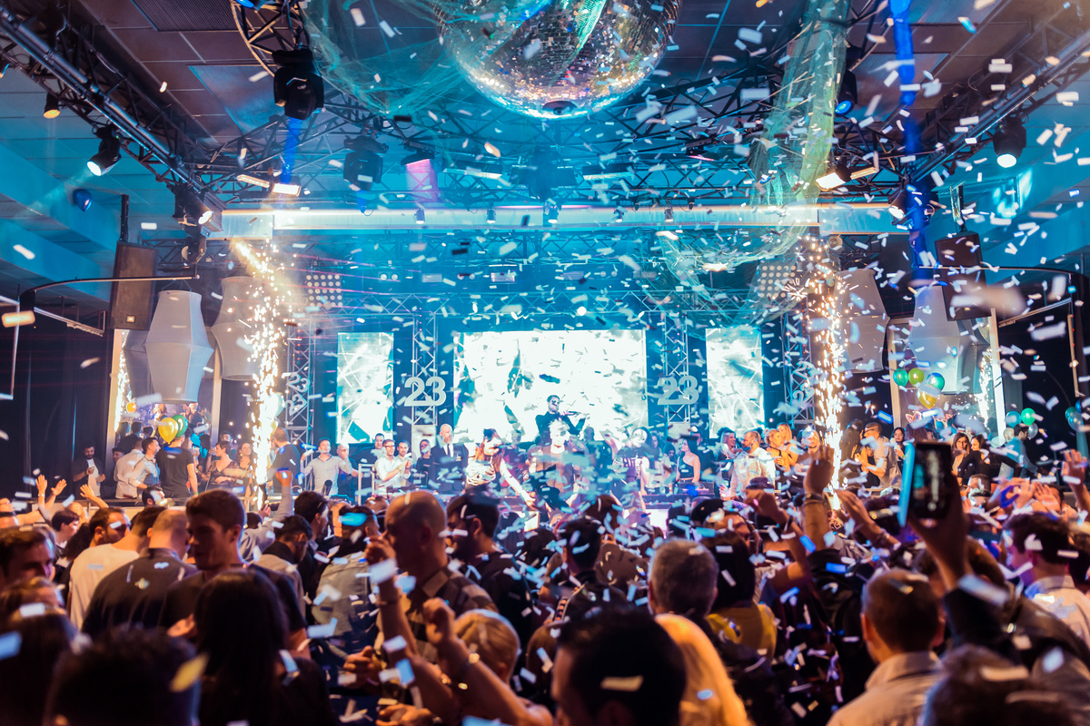





Agenda Overview
MONDAY
TUESDAY
Arrivals + Welcome Party
Co-Working +
Food Tour
WEDNESDAY
Morning Kayak + Boarding Meeting

Slide 5


THANK YOU FOR JOINING US!

