Slide 1



OFFSITE
MEMORIES
SAN FRANCISCO - Q3 2022

Slide 2


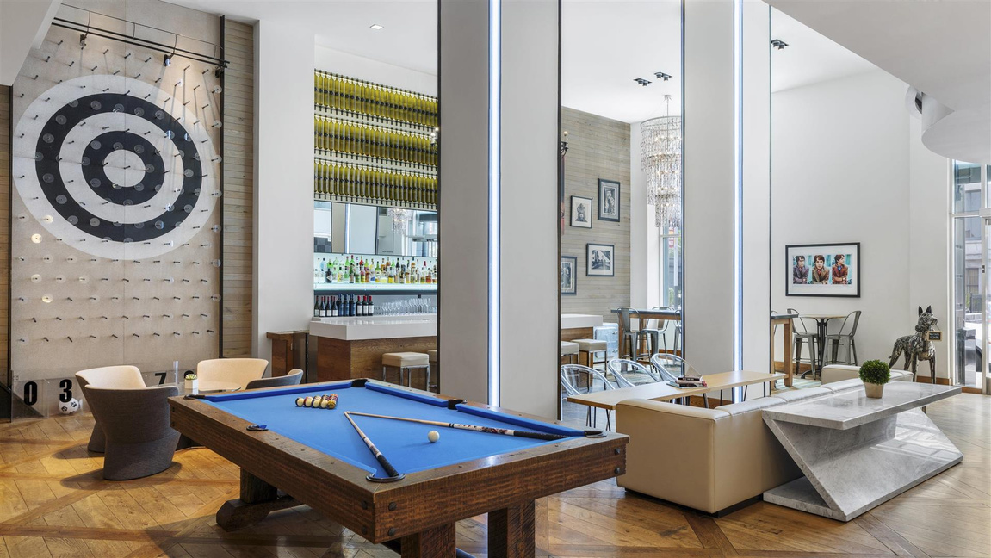
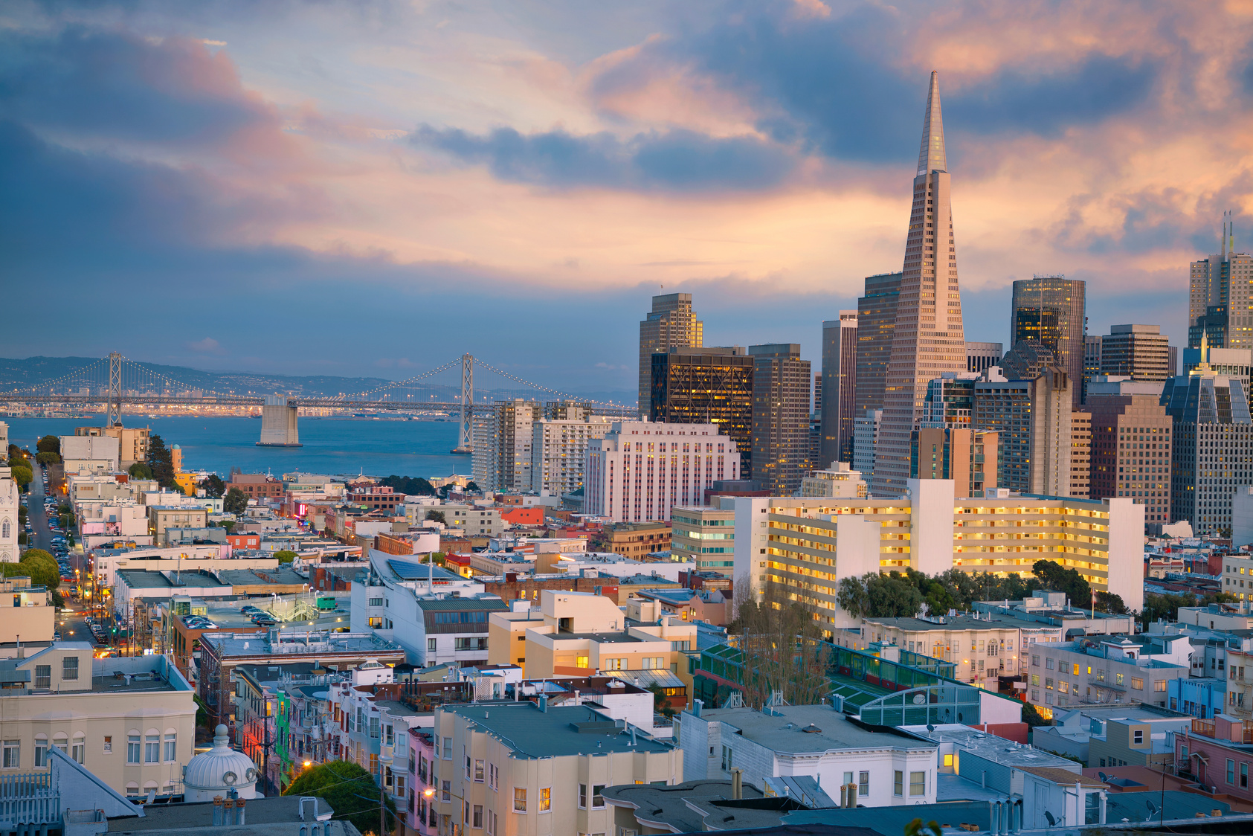
A BEAUTIFUL ADVENTURE
IN A ONE-OF-A-KIND CITY
HOTEL ZETTA
SAN FRANCISCO

Slide 3
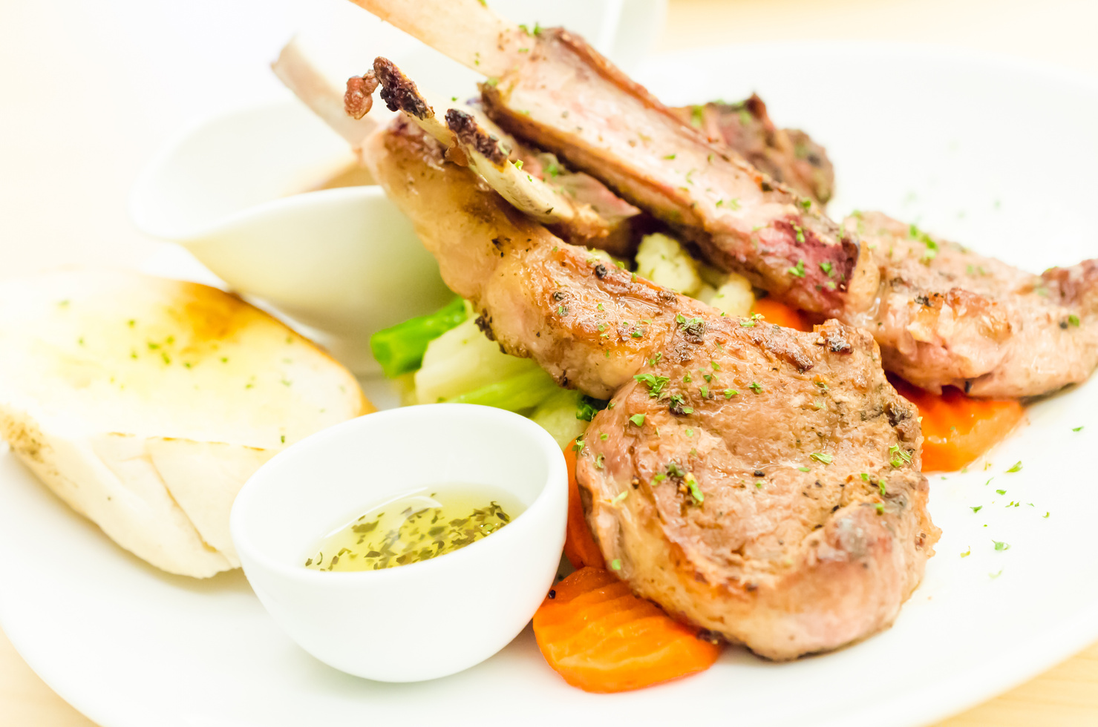
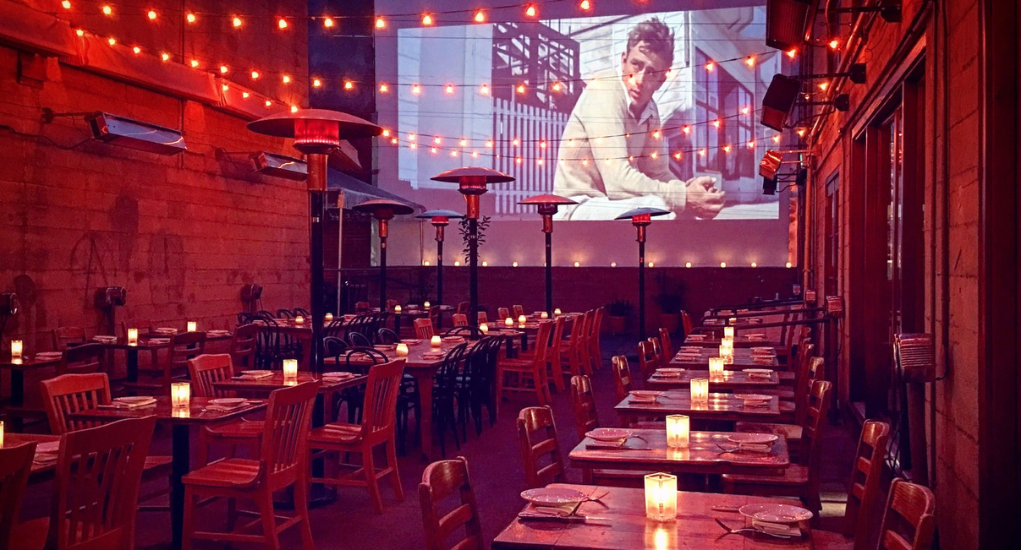
DELICIOUS MEALS AT WORLD-CLASS VENUES
KOKKARI ESTIATORIO
FOREIGN CINEMA

Slide 4
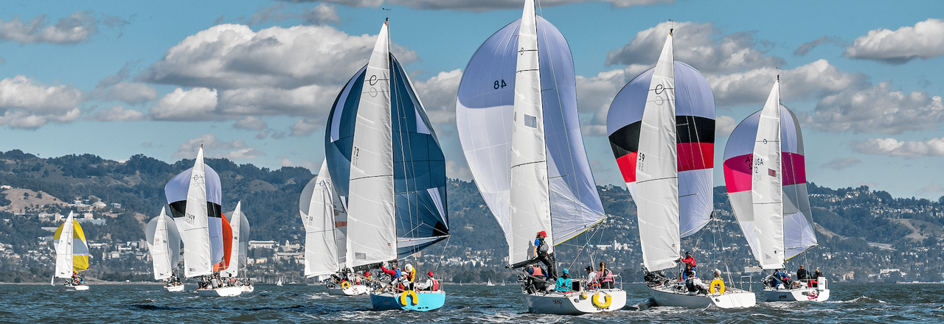
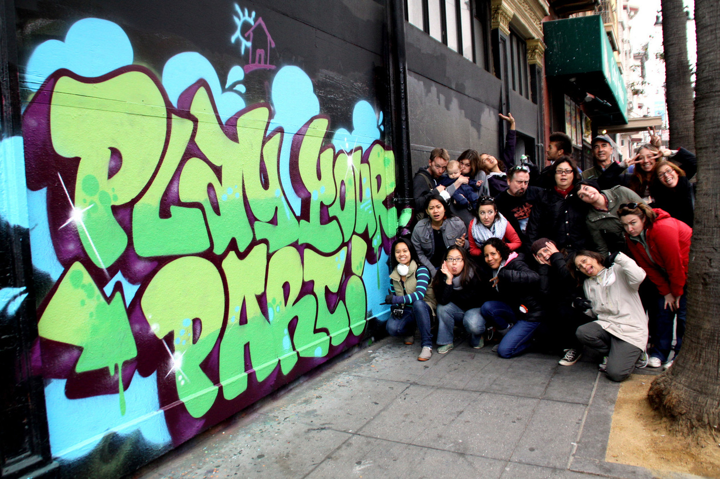
EXCITING ACTIVITIES
YACHT REGATTA
GRAFITTI TOUR

Slide 5
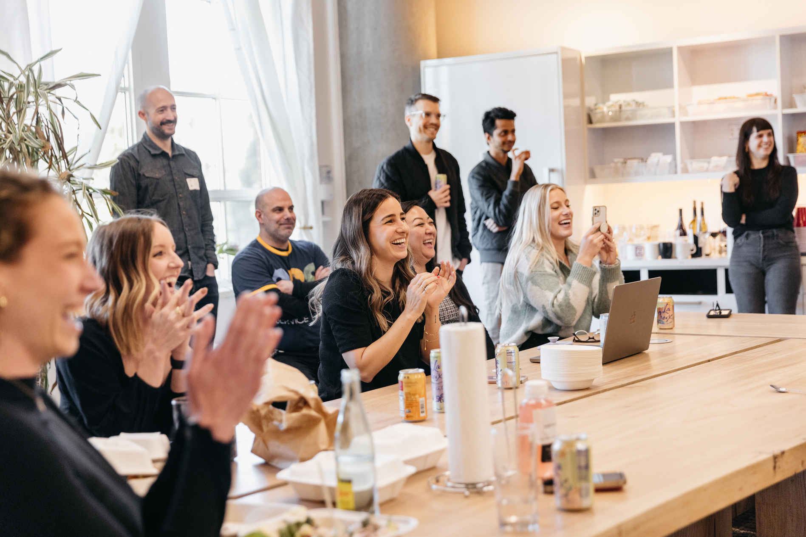
THANK YOU FOR JOINING US!

Slide 6

WHERE TO NEXT?

